Slide 1
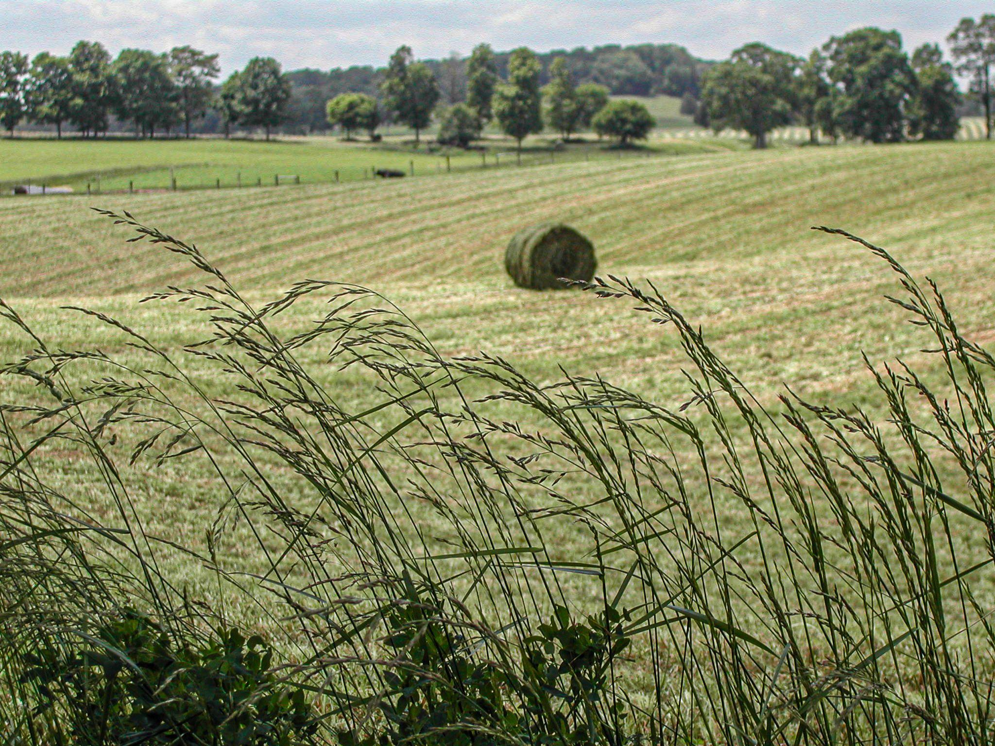
Identifying Common Pasture Plants
Stephanie Q. Smith Dr. Ray Smith Dr. Jimmy Henning Krista Lea
Notes:
Hello and welcome to identifying common pasture plants!

Slide 2
Overview
Introduction
Common Desirable Pasture Grasses
Common Pasture Legumes
Common Pasture Weeds
Top 5 Review
Acknowledgments
Stephanie Q. Smith
UK Equine Science & Management Student
Forage Department Intern
Notes:
My name is Stephanie Smith and I am an Equine Science and Management student at the University of Kentucky. One of my projects as an intern with the UK Forage group was to put together this video to teach you guys how to easily identify common pasture plants.

Slide 3
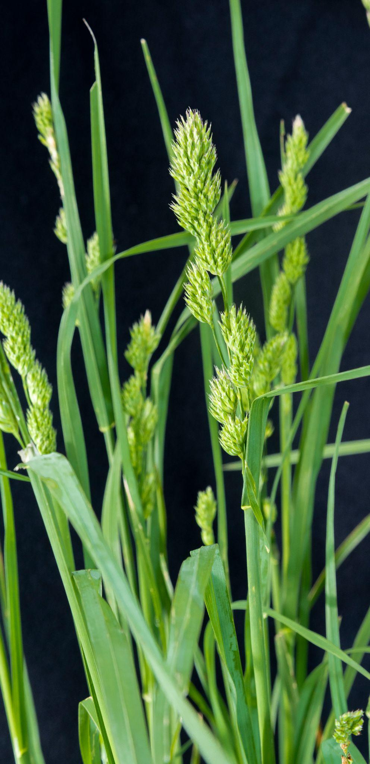
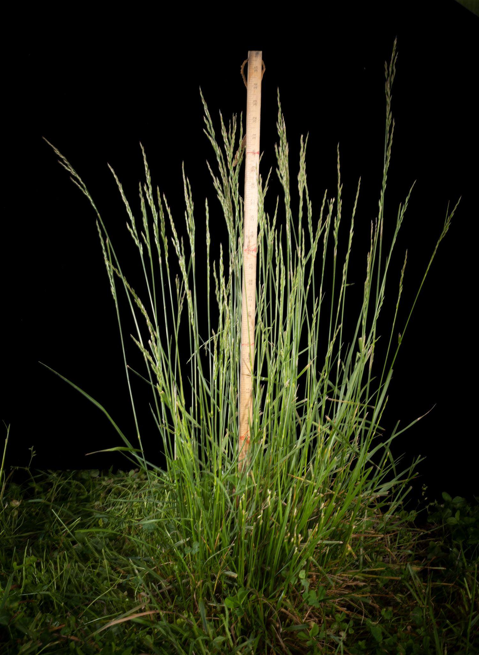
Common Desirable Pasture Grasses
Kentucky Bluegrass
Orchardgrass
Tall Fescue
Notes:
Kentucky bluegrass, orchardgrass, and tall fescue are the most common grasses that producers see in their pastures. It’s important to remember that the majority of fields are not monocultures, meaning they are composed of many different species of plants, not just one type of grass. Pastures often include many species of weeds as well, but we will talk about them later. Kentucky pastures are commonly a mix of the grasses you see here: bluegrass, orchardgrass, and tall fescue.

Slide 4
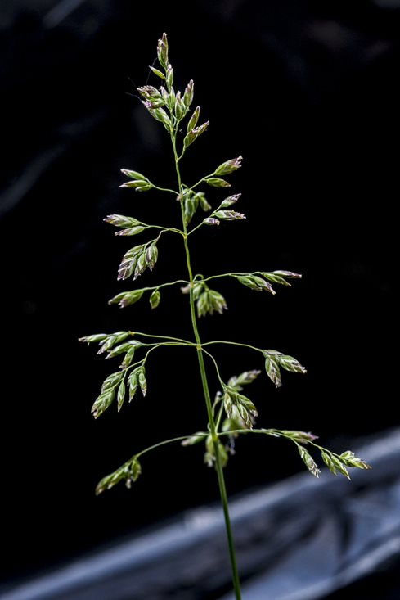
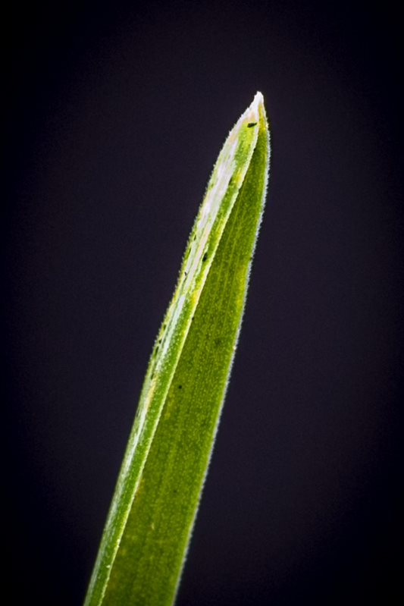
Kentucky Bluegrass
Notes:
Kentucky Bluegrass is a perennial grass known for its narrow leaves and dark green color. One identifying characteristic to look for is the tip of the leaf: it is shaped like the keel of a boat. It also has a prominent midrib with lighter-colored lines on either side. The bluegrass seedhead is distinctive as it is pyramid shaped, and has a purple/blue tint which gives the grass its name.

Slide 5
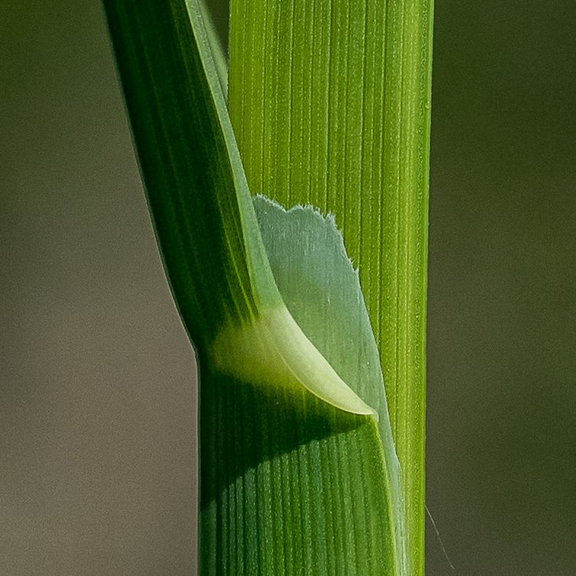
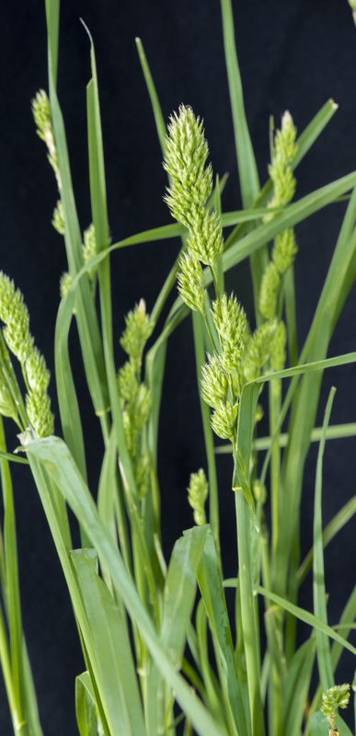
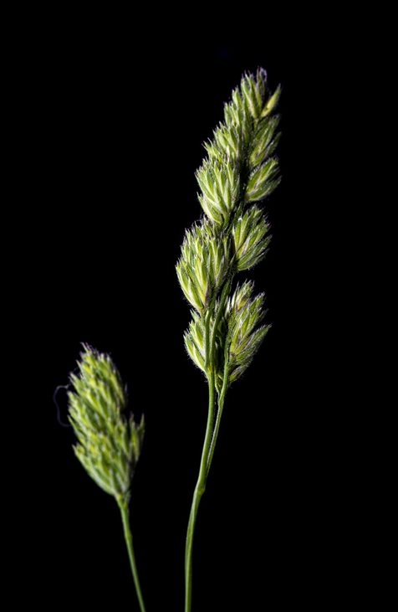
Orchardgrass
Notes:
Orchardgrass is a perennial grass with soft, lax leaves, and a prominent midvein. The ligule (like a scarf or shirt collar), circled here in red, is often easy to spot. The base of orchardgrass stems are flat, compared to tall fescue which are more round. You can feel the difference if you try to roll the stems between your fingers. The tips of orchardgrass leaves are often torn or look shredded since they are so soft. The seed head is distinctive, looking like tufts.

Slide 6
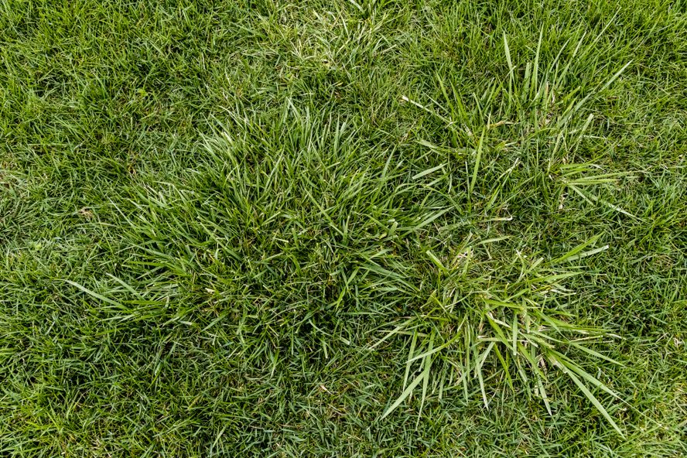
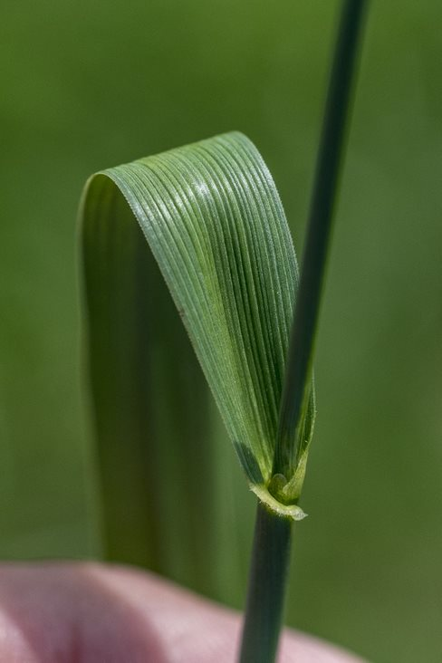
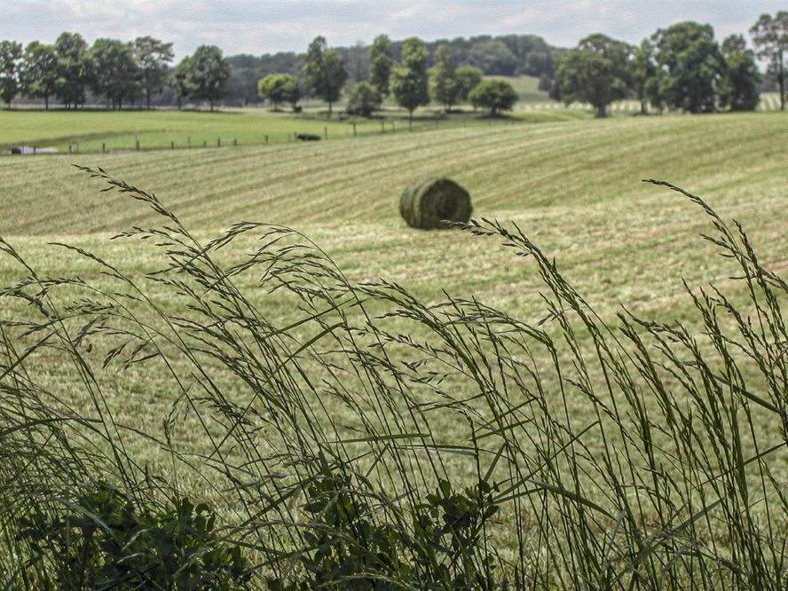
Tall Fescue
Notes:
Tall fescue is also a perennial grass. It has wide, flat leaf blades with no prominent midvein. Instead the veins are equal in size and form ridges along the blade. The edges of tall fescue leaves are rough (actually serrated), and feel like a papercut if the leaves slide against your fingers or legs. Tall fescue has auricles, circled here in red, that wrap around the leaf base. The auricles look kind of like crab claws. You can see that the stems are rolled, unlike the flat orchardgrass stems. Tall fescue leaves are glossy on the underside, which can help you distinguish tall fescue from bluegrass or orchardgrass because they are not shiny. Tall fescue seed heads are usually more linear in shape, except for when they open up to release pollen.

Slide 7
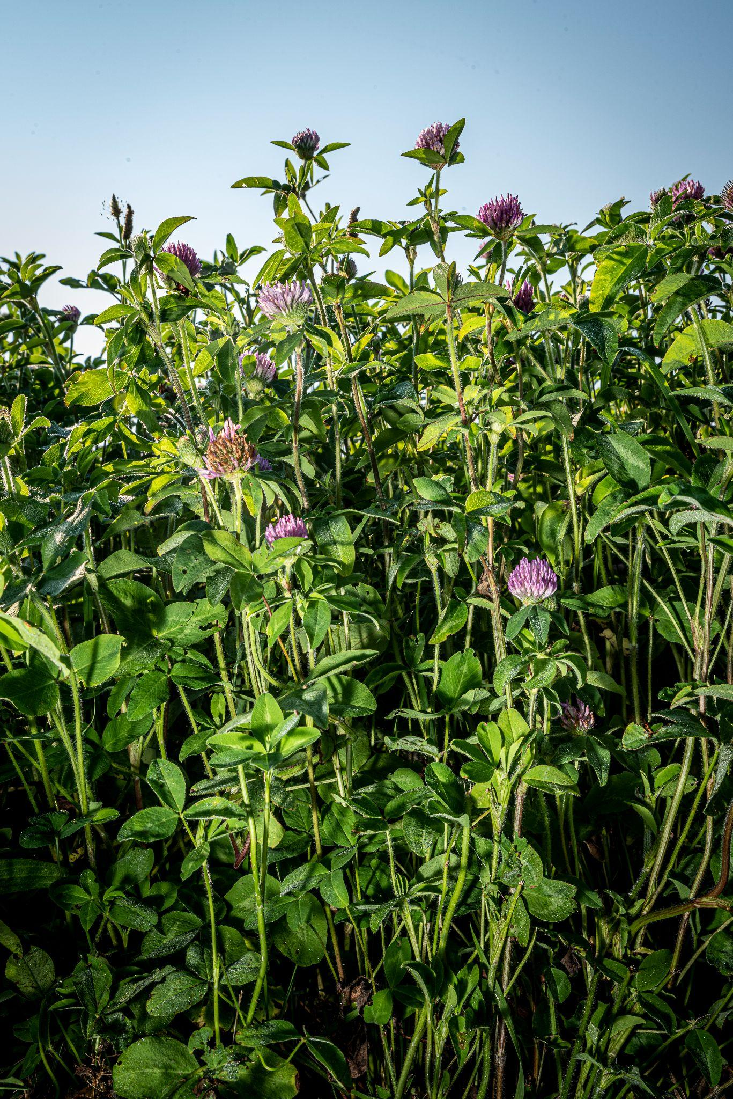
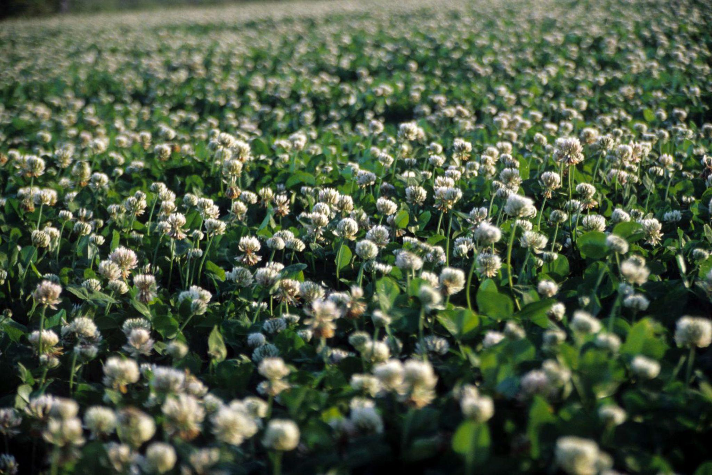
Common Desirable Pasture Legumes
Red Clover
White Clover
Notes:
Other than grasses, producers may also want legumes in their pastures. Red and white clover, shown here, are the most common. Alfalfa is also a legume but is not commonly used for grazing.

Slide 8
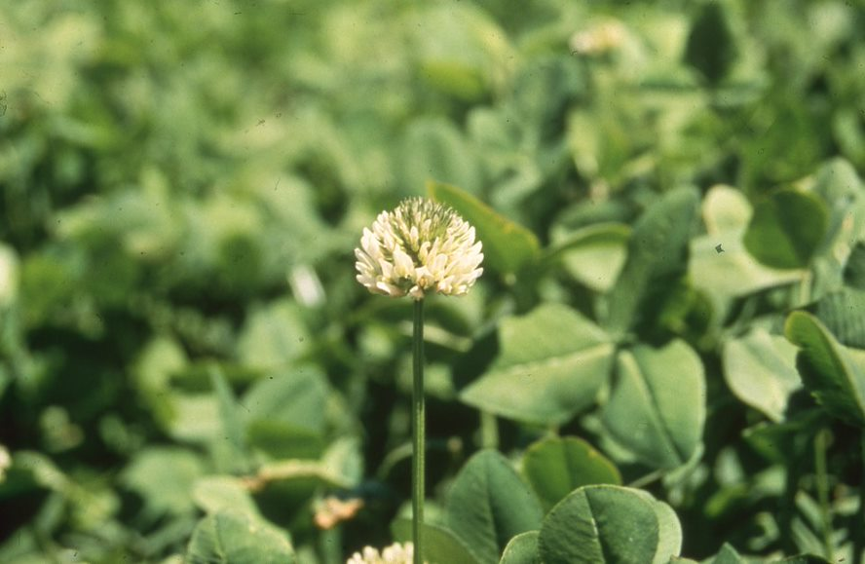
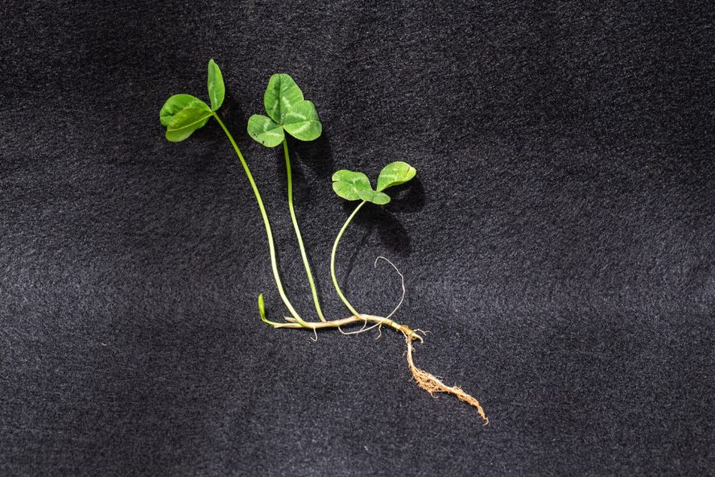
White Clover
Notes:
White clover is easy to identify when it has blossoms, which you can see in this picture on the right. The leaves are small and rounded, usually three per stem (unless you’re lucky and find one with four!). The stems are smooth and hairless. White clover is low growing compared to red clover and most grasses.

Slide 9
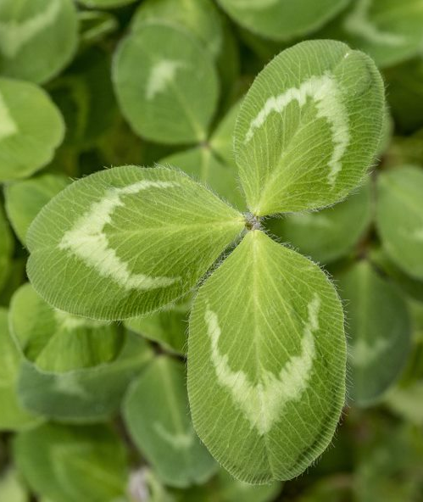
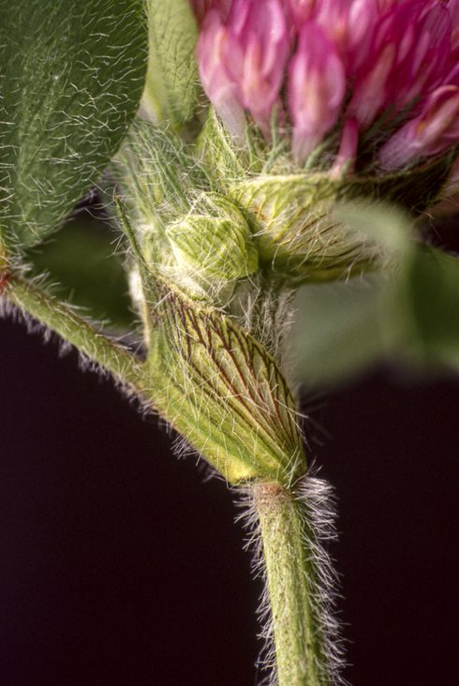
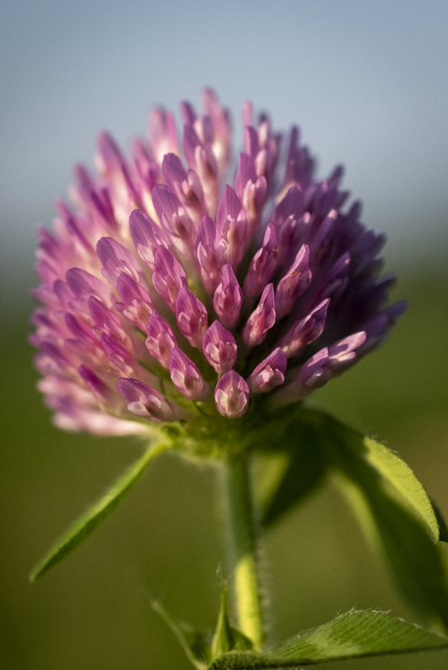
Red Clover
Notes:
The best way to identify red clover is by its distinctive reddish-pinkish-purple blossoms and hairy stems and leaves. The leaves are usually larger than white clover leaves, but that may depend on their stage of growth. Red clover grows taller than white clover and does best under rotational grazing.

Slide 10
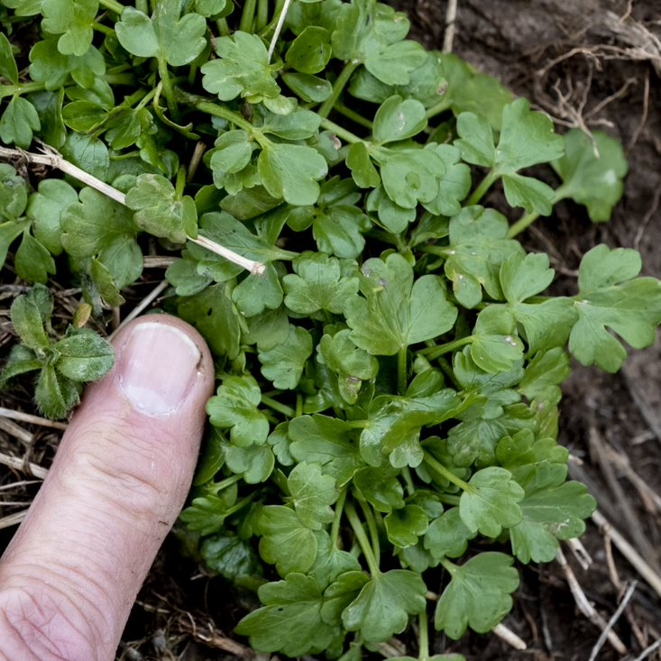
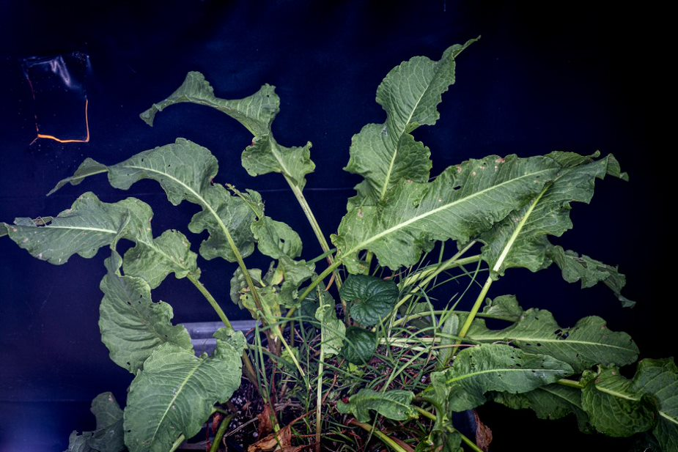
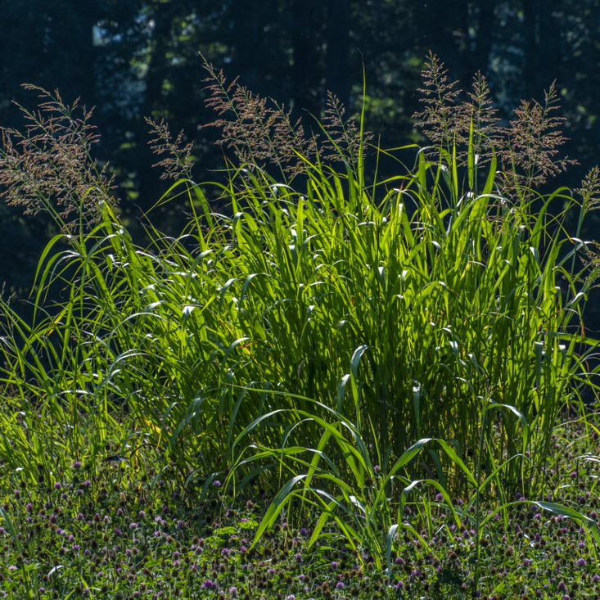
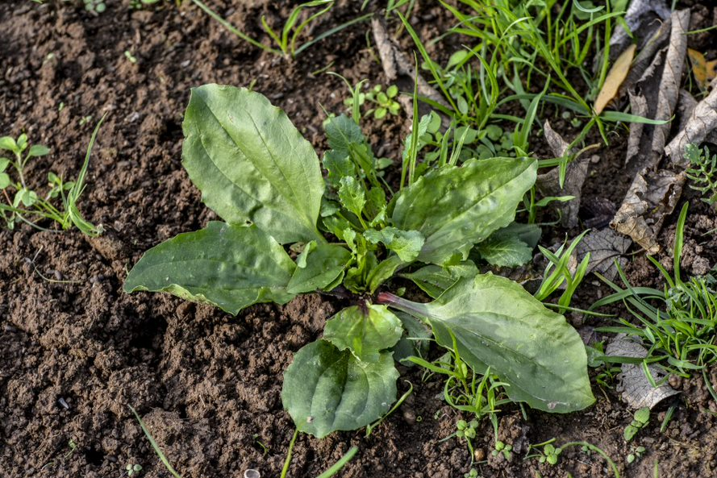
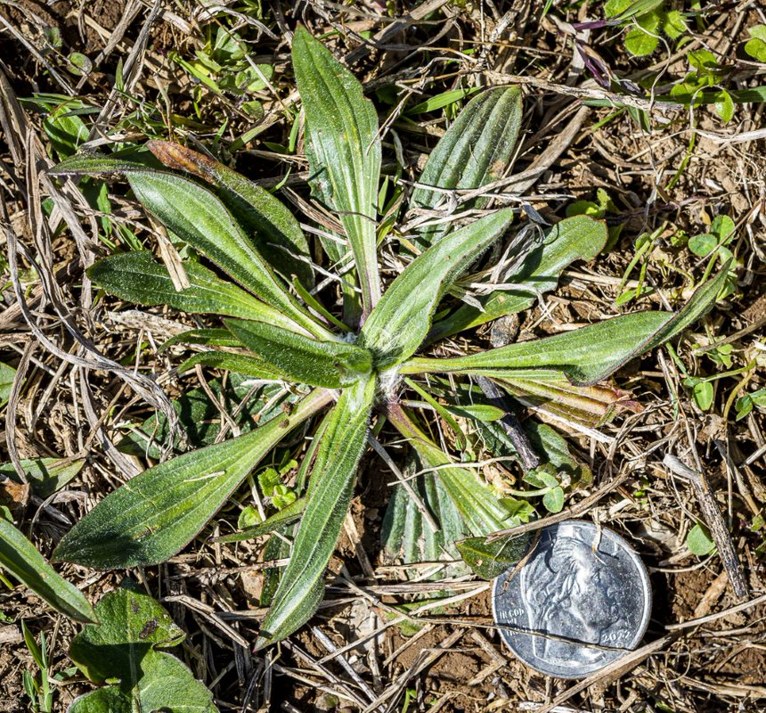
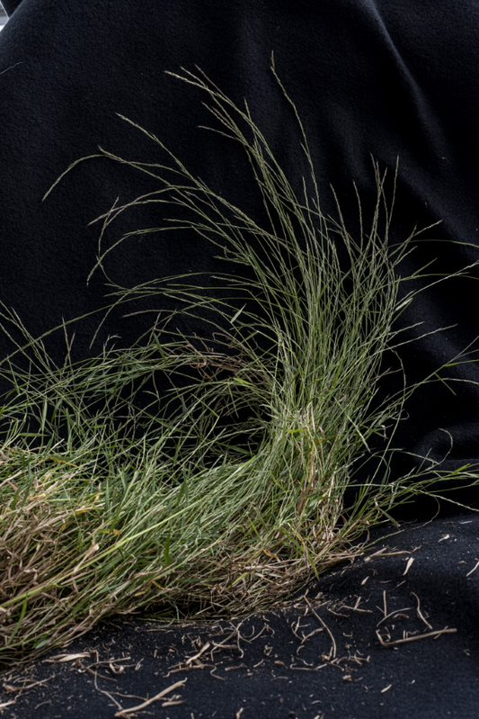
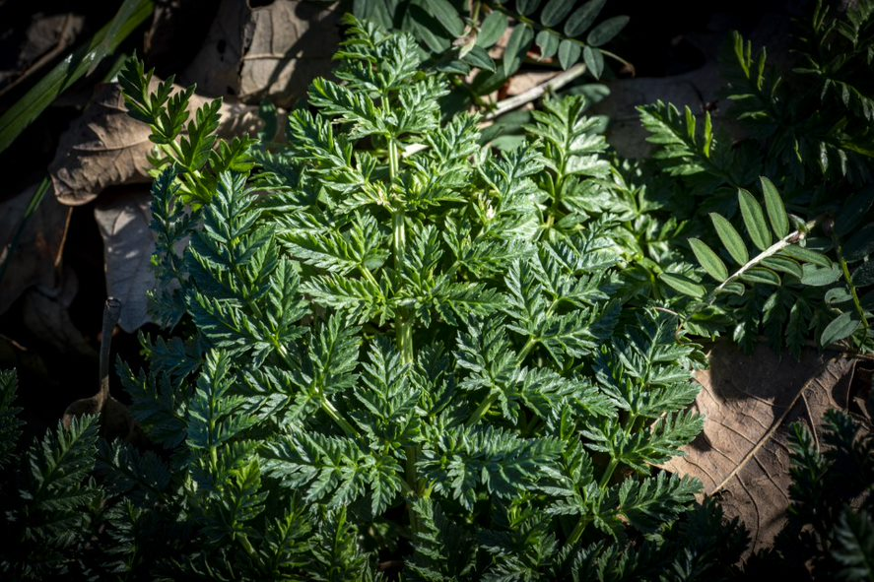
Common Pasture Weeds
Broadleaf Plantain
Buttercup
Curly Dock
Johnsongrass
Narrowleaf Plantain
Nimblewill
Poison Hemlock
Ragweed
Notes:
That wraps up the most common grasses and legumes found in pastures. Now I’m going to help you learn to identify some of Kentucky’s common pasture weeds. We’re going to go through them in alphabetical order.

Slide 11
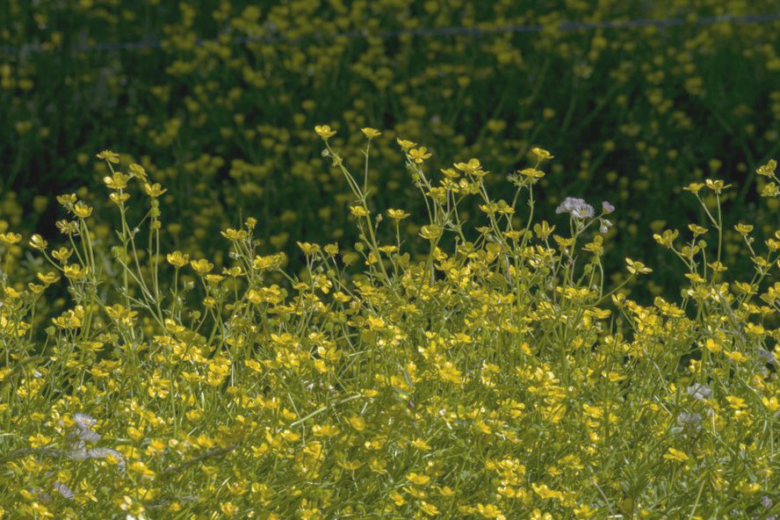
Buttercup
Henning
Henning
Notes:
First is buttercup. This is easy to identify when it has its flowers, but by the time you see the flowers, it is too late to spray herbicides to get rid of it. You’re going to want to pay close attention to the picture on the left, because this is what the young buttercup plant looks like. This is the stage you need to be able to identify if you’re wanting to try to get this weed out of your pastures. Note that the leaves are pretty small at this stage, just larger than an average thumbnail.

Slide 12
Curly Dock
Notes:
The weed pictured here is known as curly dock. It should not be confused with plantain. As you can see from this picture, dock can get pretty large, often more than one foot in diameter. The leaves are long and curled. It looks similar to a long lettuce leaf, but I would not recommend adding curly dock to your salads.

Slide 13
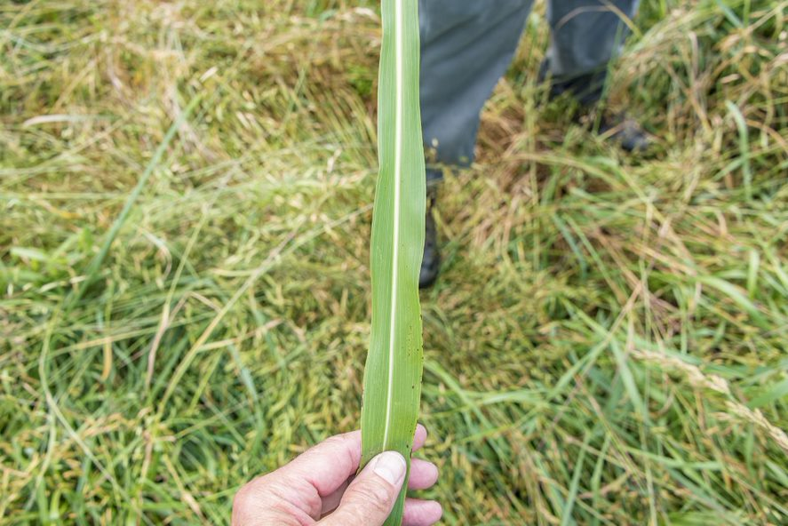
Johnsongrass
Notes:
Our next weed is actually a grass (called johnsongrass), but in our pastures producers consider this a weed because it has invasive tendencies. When everything is growing well, johnsongrass is easy to spot because it gets much taller than the rest of the pasture grasses which you can see from the picture on the left. With the seedheads, it can easily be 3-6 feet tall. The seed heads look like a giant version of bluegrass seed heads but are generally much more reddish-purple in color. Johnsongrass leaves look like skinny corn leaves due to their coloring and the distinctive white midrib, which you can see here in the picture on the right.

Slide 14
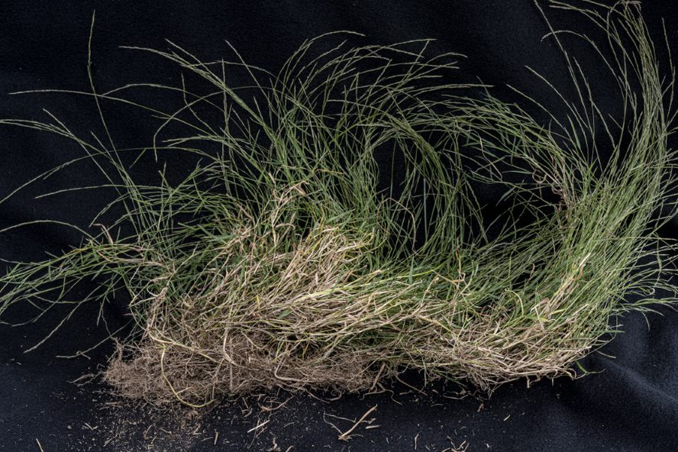
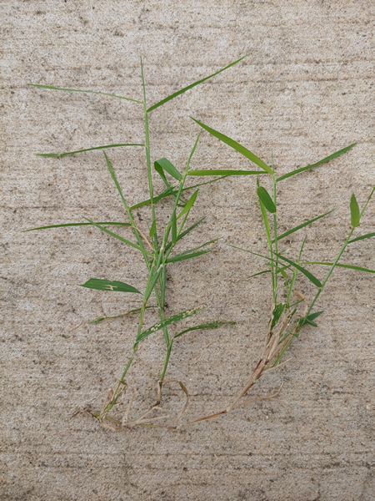
Nimblewill
Photo credit to University of Illinois Extension
Notes:
This weed is also a warm season grass, called nimblewill. It looks similar to bermudagrass, but grows more upright than laterally like bermudagrass does. It is also very shallow-rooted, and can easily be pulled up from the ground by hand. Bermudagrass does not come up easily, so that’s another way to tell the difference. When nimblewill is small/young, the leaves really stick out horizontally at almost a 90 degree angle, so it almost looks like a scarecrow’s arms. Nimblewill goes brown after a frost, which results in brown patches throughout the pasture. Livestock will not eat nimblewill, so it may be the only thing left in an overgrazed pasture. You’ll be able to easily see the ungrazed patches sticking up.

Slide 15
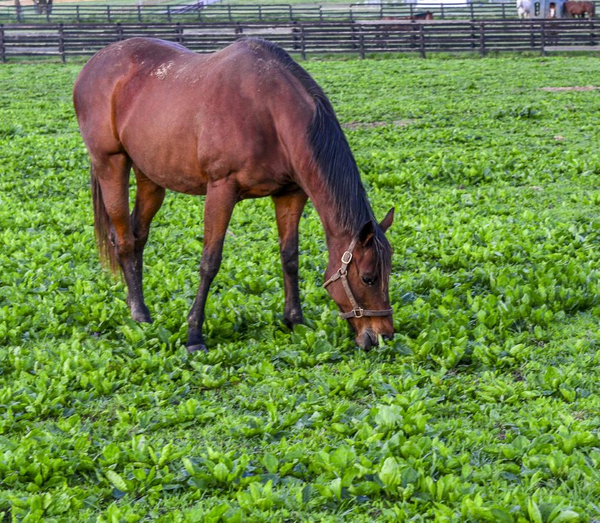
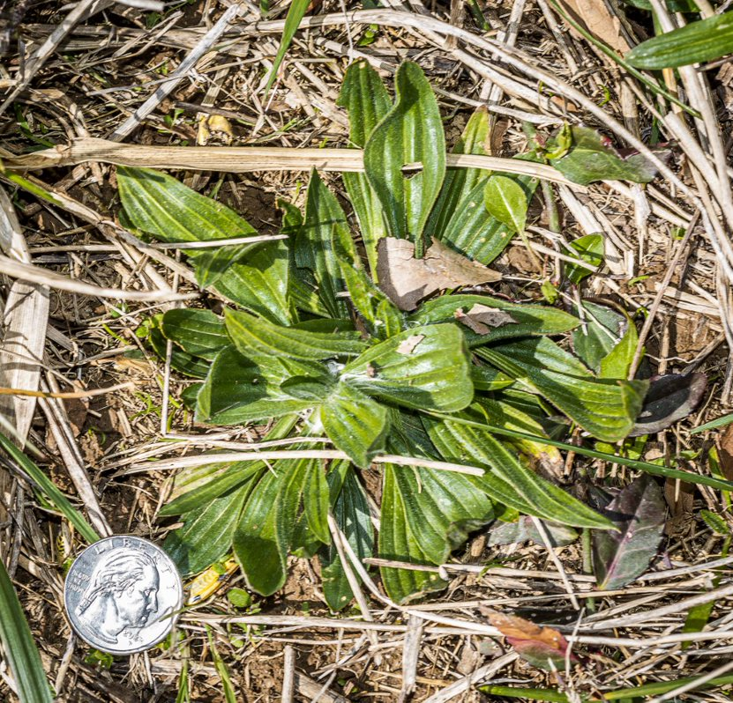
Plantain, Narrowleaf and Broadleaf
Notes:
Plantains are very common in livestock pastures. They have waxy, almost shiny leaves and come in many types. The most common types, shown here, are narrowleaf or lance leaf plantain seen on the right, and then broadleaf plantain, seen on the left. Plantain leaves rarely get longer than 4 inches, so they are smaller weeds. You can see this size, and their ability to fill in bare soil quickly, in the image with the horse here. The main way to tell the difference between narrowleaf and broadleaf plantain is by the shape of the leaves. Broadleaf plantain is usually round and larger, while narrowleaf is skinnier and longer.

Slide 16
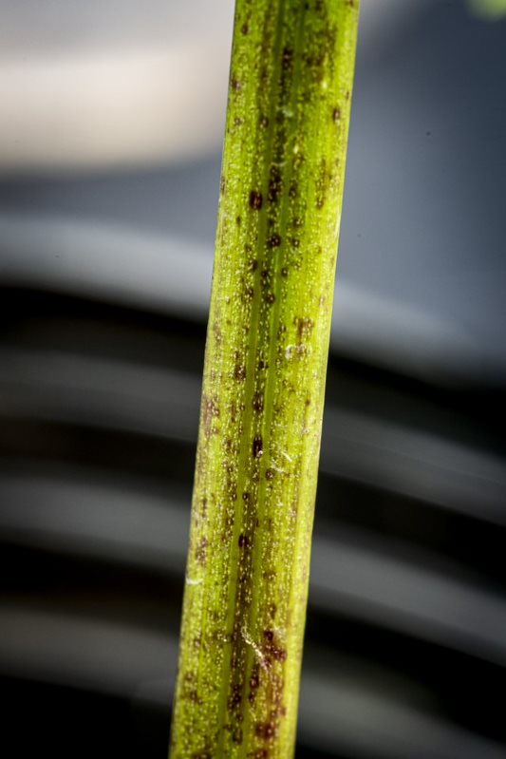
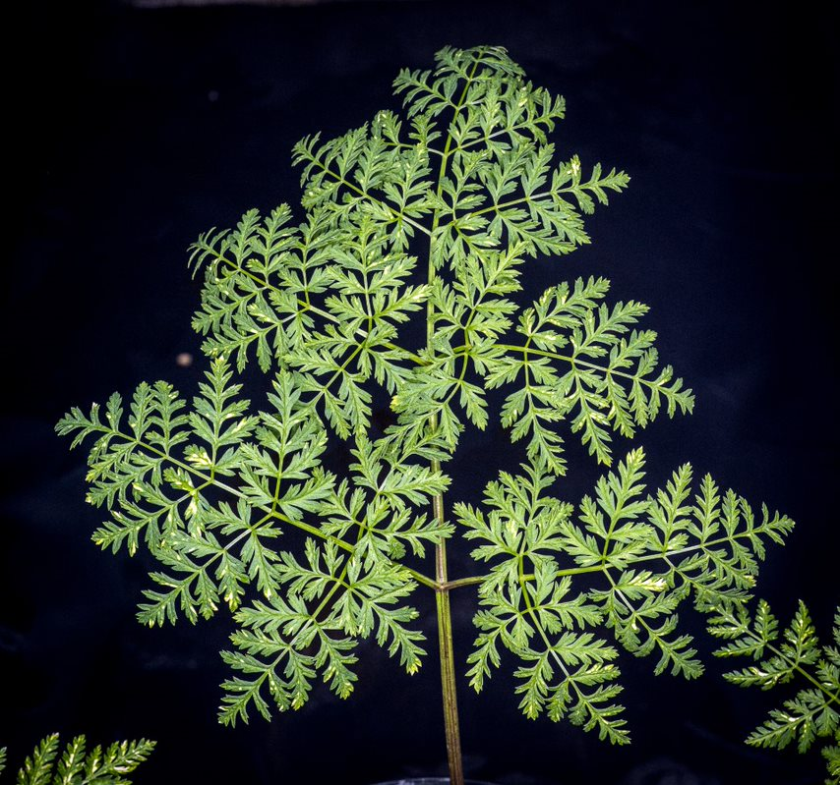
Poison Hemlock
Notes:
Poison hemlock is very common in Kentucky. You’ve probably even seen it growing along the sides of the roads. At small stages, the leaves are delicate looking, and lacey. They look a lot like carrot tops or queen anne’s lace. One way to help tell the difference between queen anne's lace and poison hemlock is to look at the stems. Hemlock stems usually have a purplish tint. I remember this distinction as “purple is poison.” When it gets tall enough, it produces large white flowers. Poison hemlock grows 3-6 feet tall. Fortunately, animals generally do not eat this weed, but if they do it is toxic.

Slide 17
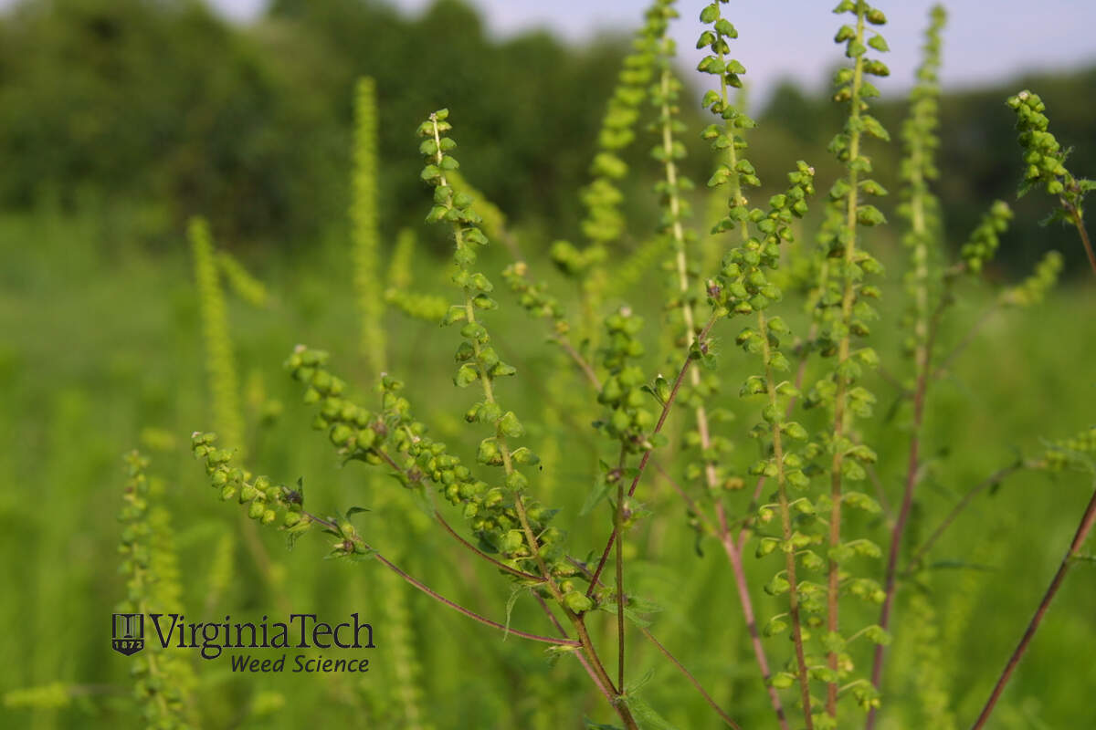
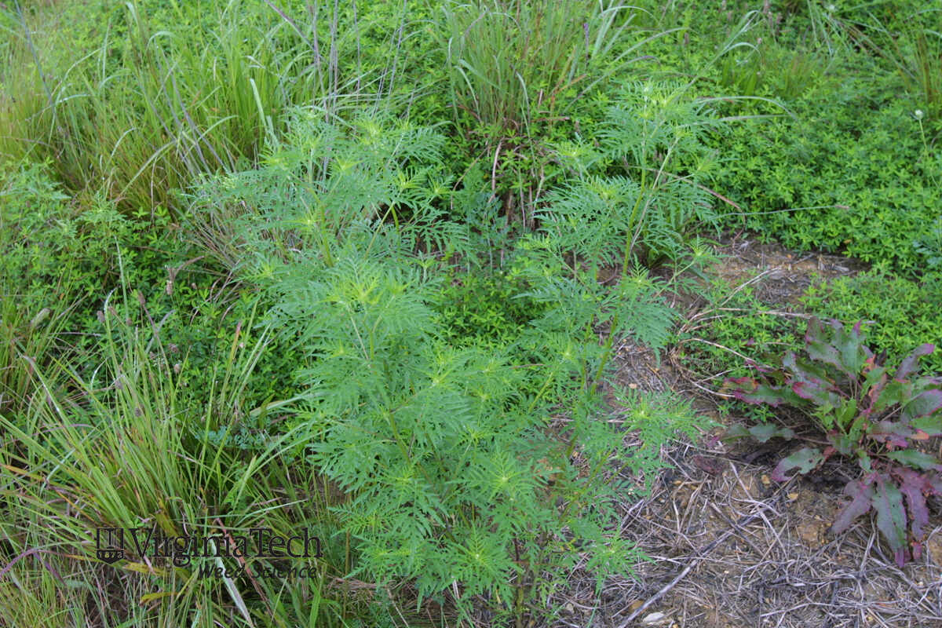
Ragweed
Photo credit to University of Kentucky Weed Science
Photo credit to Virginia Tech Weed Science
Notes:
Our last common pasture weed is ragweed. It germinates in hot weather, especially during the summer, so you won’t see it in your pastures year-round. There are many varieties of ragweed. We often see common ragweed and giant ragweed in Kentucky. I think ragweed leaves look kind of like fern leaves, but ragweed will have flowers in mature stages while ferns do not have flowers. Ragweed can also look similar to poison hemlock, but the main difference is the flowers and lack of purple stems. Ragweed leaves are also less lacey and intricate.

Slide 18
Top 5 Review
Tall Fescue
Kentucky Bluegrass
Buttercup
Poison Hemlock
Orchardgrass
Notes:
Now that we’ve talked about some of the most common plants that can be found in Kentucky pastures, let’s review my top 5 and how to identify them. For Kentucky Bluegrass, look for its narrow leaves, dark green color, and boat-shaped tip. Kentucky bluegrass is the picture here in the top right corner. For orchardgrass, look for the soft, lax leaves, prominent midvein, and flat stem bases. You can see how flat the base is in the bottom right picture compared to the tall fescue stem to the left. For Tall fescue, look for ridged leaves, serrated edges, claw-like auricles, and round stem bases. My top two weeds are buttercup and poison hemlock. Both are toxic and have a steadily increasing presence in Kentucky. For poison hemlock, look for carrot-like leaves and purplish stems. For buttercup, look for clumps of small leaves that have three rounded portions.

Slide 19
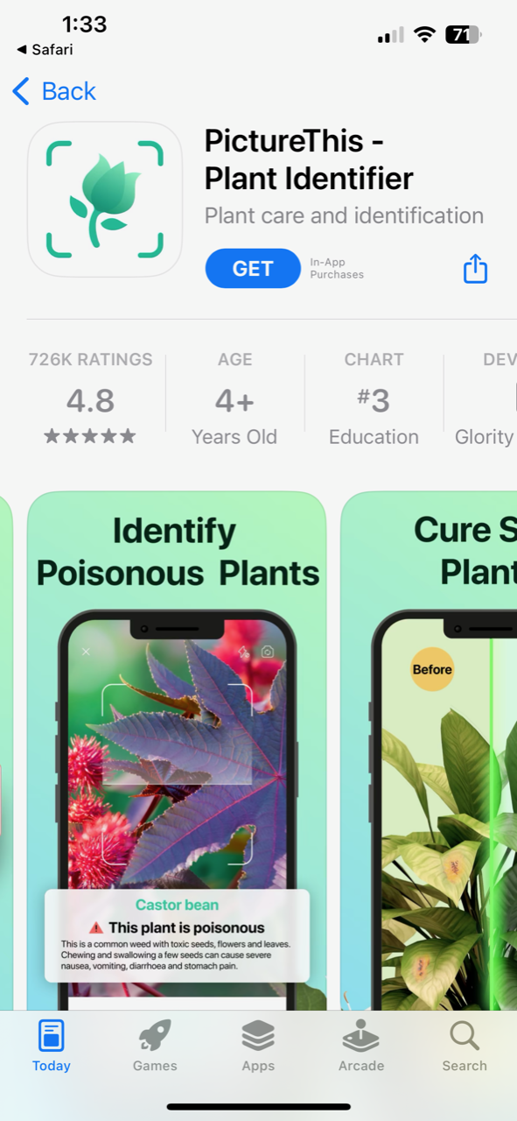
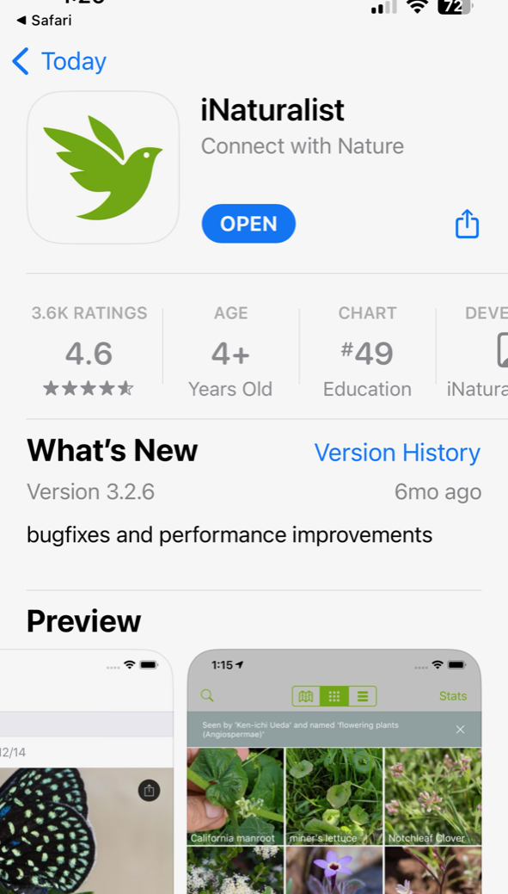
Special Thanks to:
Our Recommended Apps
Dr. Ray Smith
Dr. Jimmy Henning
Krista Lea
University of Kentucky College of Agriculture, Food and Environment’s Forage Group
Special thanks to Jimmy C. Henning for the photographs in this presentation.
$29.99/ year
Free to Download
Notes:
Thank you guys for joining me today and learning how to identify common pasture plants! I wanted to mention a couple of apps that are really helpful with identifying plants. “Picture This” is the one we use for the UK Horse Pasture Evaluation Program and it is super easy to use. iNaturalist is another app that we recommend for plant identification, and it is free to download. I also wanted to thank Dr. Ray Smith for his contributions to this video and for being a great mentor during my internship. I’d also like to thank Krista Lea for teaching me how to identify these plants through the UK Horse Pasture Evaluation Program. Another big thanks to Dr. Jimmy Henning for the amazing photos he allowed me to use for this presentation! All photo credits go to Dr. Henning unless otherwise noted.

